Slide 1
CAP442 Web Technology
Unit III
Session 6
II Year M.C.A

Slide 2
Contents
Introduction to PHP
Expressions and Control flow
PHP functions and objects
Arrays
Form handling
Cookies, Sessions and Authentication
Introduction to MySQL
Accessing MySQL using PHP

Slide 3
Form Handling
Building Forms
Handling forms is a multipart process.
First is the creation of a form into which a user can enter the required details.
This data is then sent to the web server, where it is interpreted, often with some error checking.
If the PHP code identifies one or more fields that require reentering, the form may be redisplayed with an error message.
When the code is satisfied with the accuracy of the input, it takes some action that usually involves the database, such as entering details about a purchase.

Slide 4
To build a form, you must have at least the following elements:
An opening <form> and closing </form> tag
A submission type specifying either a GET or POST method
One or more input fields
The destination URL to which the form data is to be submitted

Slide 5
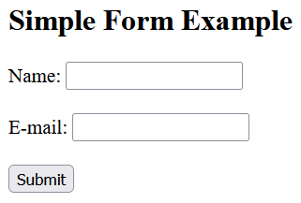
<html> <body> <form action="welcome.php" method="post"> Name: <input type="text" name="name"><br><br> E-mail: <input type="text" name="email"><br><br> <input type="submit“ value=“Submit”> </form> </body> </html>
The example displays a simple HTML form with two input fields and a submit button

Slide 6
Retrieving Submitted Data
The html form is only one part of the multipart form-handling process.
If we enter a name, mail id and click the Submit button, error page will be displayed (“welcome.php” file not found error)
So now it’s time to add some PHP code to process the data submitted by the form

Slide 7
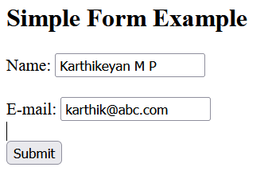

To display the submitted data we can use echo statement. The "welcome.php" looks like this:
<html> <body style=“font-size:20px”> Welcome <?php echo $_POST["name"]; ?><br> Your email address is: <?php echo $_POST["email"]; ?> </body> </html>

Slide 8
Browser sends user input through either a GET request or a POST request.
The web server bundles up all of the user input (even if the form was filled out with a hundred fields) and puts in into an array named $_POST.
$_POST is an associative array.
Depending on whether a form has been set to use the POST or the GET method, either the $_POST or the $_GET associative array will be populated with the form data.
Each field has an element in the array named after that field. So, if a form contains a field named “email”, the $_POST array contains an element keyed by the word “email”.
The PHP program can read that field by referring to either $_POST[‘email'] or $_POST[“email"]

Slide 9
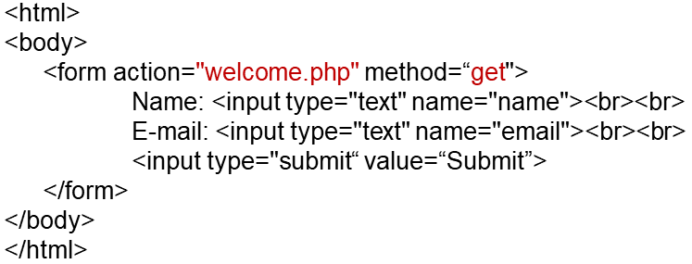
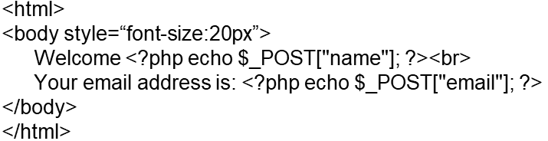
The same program can be implemented using GET method

Slide 10
GET vs. POST
Both GET and POST create an array (e.g. array( key1 => value1, key2 => value2, key3 => value3, ...)). This array holds key/value pairs, where keys are the names of the form controls and values are the input data from the user.
Both GET and POST are treated as $_GET and $_POST. These are superglobals, which means that they are always accessible, regardless of scope - and you can access them from any function, class or file without having to do anything special.
$_GET is an array of variables passed to the current script via the URL parameters.
$_POST is an array of variables passed to the current script via the HTTP POST method.

Slide 11
When to use GET?
Information sent from a form with the GET method is visible to everyone (all variable names and values are displayed in the URL).
GET also has limits on the amount of information to send. The limitation is about 2000 characters.
However, because the variables are displayed in the URL, it is possible to bookmark the page. This can be useful in some cases.
GET may be used for sending non-sensitive data.
Note: GET should NEVER be used for sending passwords or other sensitive information!

Slide 12
When to use POST?
Information sent from a form with the POST method is invisible to others (all names/values are embedded within the body of the HTTP request) and has no limits on the amount of information to send.
Moreover POST supports advanced functionality such as support for multi-part binary input while uploading files to server.
However, because the variables are not displayed in the URL, it is not possible to bookmark the page.

Slide 13
Default Values
Sometimes it’s convenient to offer your site visitors a default value in a web form.
For example, suppose you put up a loan repayment calculator widget on a real estate website.
It could make sense to enter default values of, say, 25 years and 6 percent interest,so that the user can simply type either the principal sum to borrow or the amount that they can afford to pay each month.

Slide 14
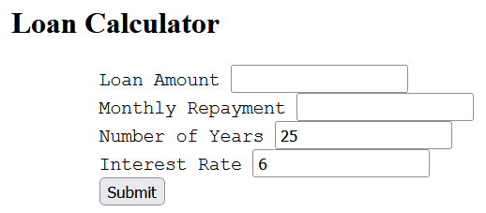
<body style="font-size:20px">
<h2>Loan Calculator</h2>
<form method="post" action="calc.php">
Loan Amount <input type="text" name="principle"><br>
Monthly Repayment <input type="text" name="monthly"><br>
Number of Years <input type="text" name="years" value="25"><br>
Interest Rate <input type="text" name="rate" value="6"><br>
<input type="submit" value="Submit">
</form>
</body>

Slide 15
Input Types
Text box
<input type="text" name="name" size="size" maxlength="length" value="value">
The size attribute specifies the width of the box (in characters)
maxlength specifies the maximum number of characters that a user is allowed to enter into the field
Required attributes are type and name. Type tells the web browser what type of input to expect, and name, for giving the input a name that will be used to process the field upon receipt of the submitted form.

Slide 16
Text areas
To accept input of more than a short line of text
This is similar to a text box, but, because it allows multiple lines, it has some different attributes
<textarea name="name" cols="width" rows="height" wrap="type">
</textarea>
cols and rows attributes are used to specify width and height
wrap attribute used to set text wrapping options
off - Text does not wrap
Soft - Text wraps, sent to the server as one long string without carriage returns
hard - Text wraps, sent to the server in wrapped format with soft returns

Slide 17
Checkboxes
To offer a number of different options to a user, from which they can select one or more items
<input type="checkbox" name="name" value="value" checked="checked">
By default, checkboxes are square.
If you include the checked attribute, the box is already checked when the browser is displayed.
The string you assign to the attribute should be either a pair of double or single quotes or the value "checked", or there should be no value assigned (just checked).

Slide 18
To allow multiple submissions, check box name should be given as array.
Vanilla <input type="checkbox" name="ice[]" value="Vanilla">
Chocolate <input type="checkbox" name="ice[]" value="Chocolate">
Strawberry <input type="checkbox" name="ice[]" value="Strawberry">
Now when the form is submitted, if any of these items have been checked an array called ice will be submitted that contains all the selected values.
We can extract either the single submitted value or the array of values to a variable like this:
$ice = $_POST['ice'];
foreach($ice as $item)
echo "$item<br>";

Slide 19
Radio buttons
Used when we want only a single value to be returned from a selection of two or more options.
All the buttons in a group must use the same name
Because only a single value is returned, no need to pass an array
For example, if your website offers a choice of delivery times for items purchased from your store

Slide 20
8am-Noon<input type="radio" name="time" value="1">
Noon-4pm<input type="radio" name="time" value="2" checked="checked">
4pm-8pm<input type="radio" name="time" value="3">

Slide 21
select
Lets you create a drop-down list of options, offering either single or multiple selections
<select name="name" size="size" multiple="multiple">
The attribute size is the number of lines to display. Clicking on the display causes a list to drop down, showing all the options.
If you use the “multiple” attribute, a user can select multiple options from the list by pressing the Ctrl key when clicking.

Slide 22
Your favourite vegetables
<select name="veg" size="1">
<option value="Peas">Peas</option>
<option value="Beans">Beans</option>
<option value="Carrots">Carrots</option>
<option value="Cabbage">Cabbage</option>
<option value="Broccoli">Broccoli</option>
</select>

Slide 23
Labels
With it, you can surround a form element, making it selectable by clicking any visible part contained between the opening and closing <label> tags.
For example, going back to the example of choosing a delivery time, you could allow the user to click the radio button itself and the associated text, like this:
<label>8am-Noon<input type="radio" name="time" value="1"></label>

Slide 24
The submit button
To match the type of form being submitted, you can change the text of the submit button to anything you like by using the value attribute, like this:
<input type="submit" value="Search">
You can also replace the standard text button with a graphic image of your choice, using HTML such as this:
<input type="image" name="submit" src="image.gif">

Slide 25
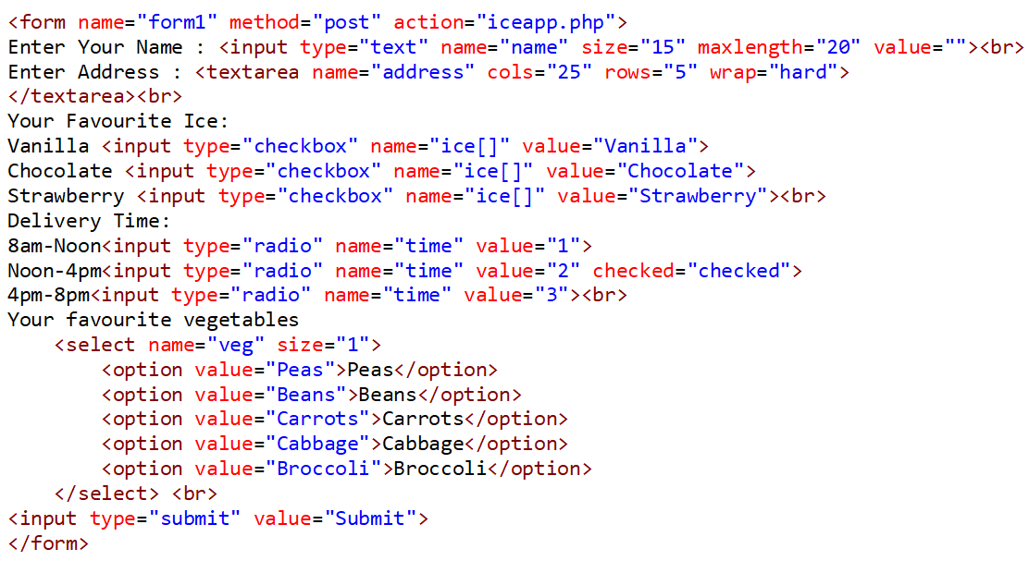

Slide 26
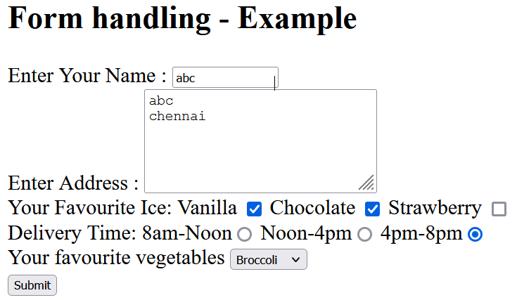
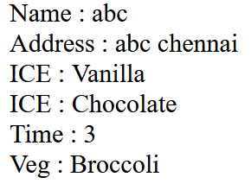

Slide 27
Sanitizing Input
Hackers can access the contents of the website using custom urls
Therefore, we must never trust any variable that fetched from either the $_GET or $_POST arrays until it is sanitized.
Instead of just using code such as the following when reading in user input:
$variable = $_POST['user_input'];
We need to remove html tags from input
Strip unnecessary characters (extra space, tab, newline) from the user input data (with the PHP trim() function)
Remove backslashes (\) from the user input data (with the PHP stripslashes() function)

Slide 28
<?php
$var = sanitizeString($_POST['user_input']);
function sanitizeString($var) {
$var = stripslashes($var);
$var = strip_tags($var);
$var = htmlentities($var);
return $var;
}
?>

Slide 29
get_magic_quotes_gpc() - will escape quotes by adding slashes
Stripslashes() – Removes unwanted slashes
strip_tags() – Removes html tags
htmlentities() – removes html entities

Slide 30
References
https://www.w3schools.com/PHP/default.asp
Robin Nixon, Learning PHP, MySQL, JavaScript, CSS & HTML5, Oreilly, Third Edition, 2014.

